Slide 1
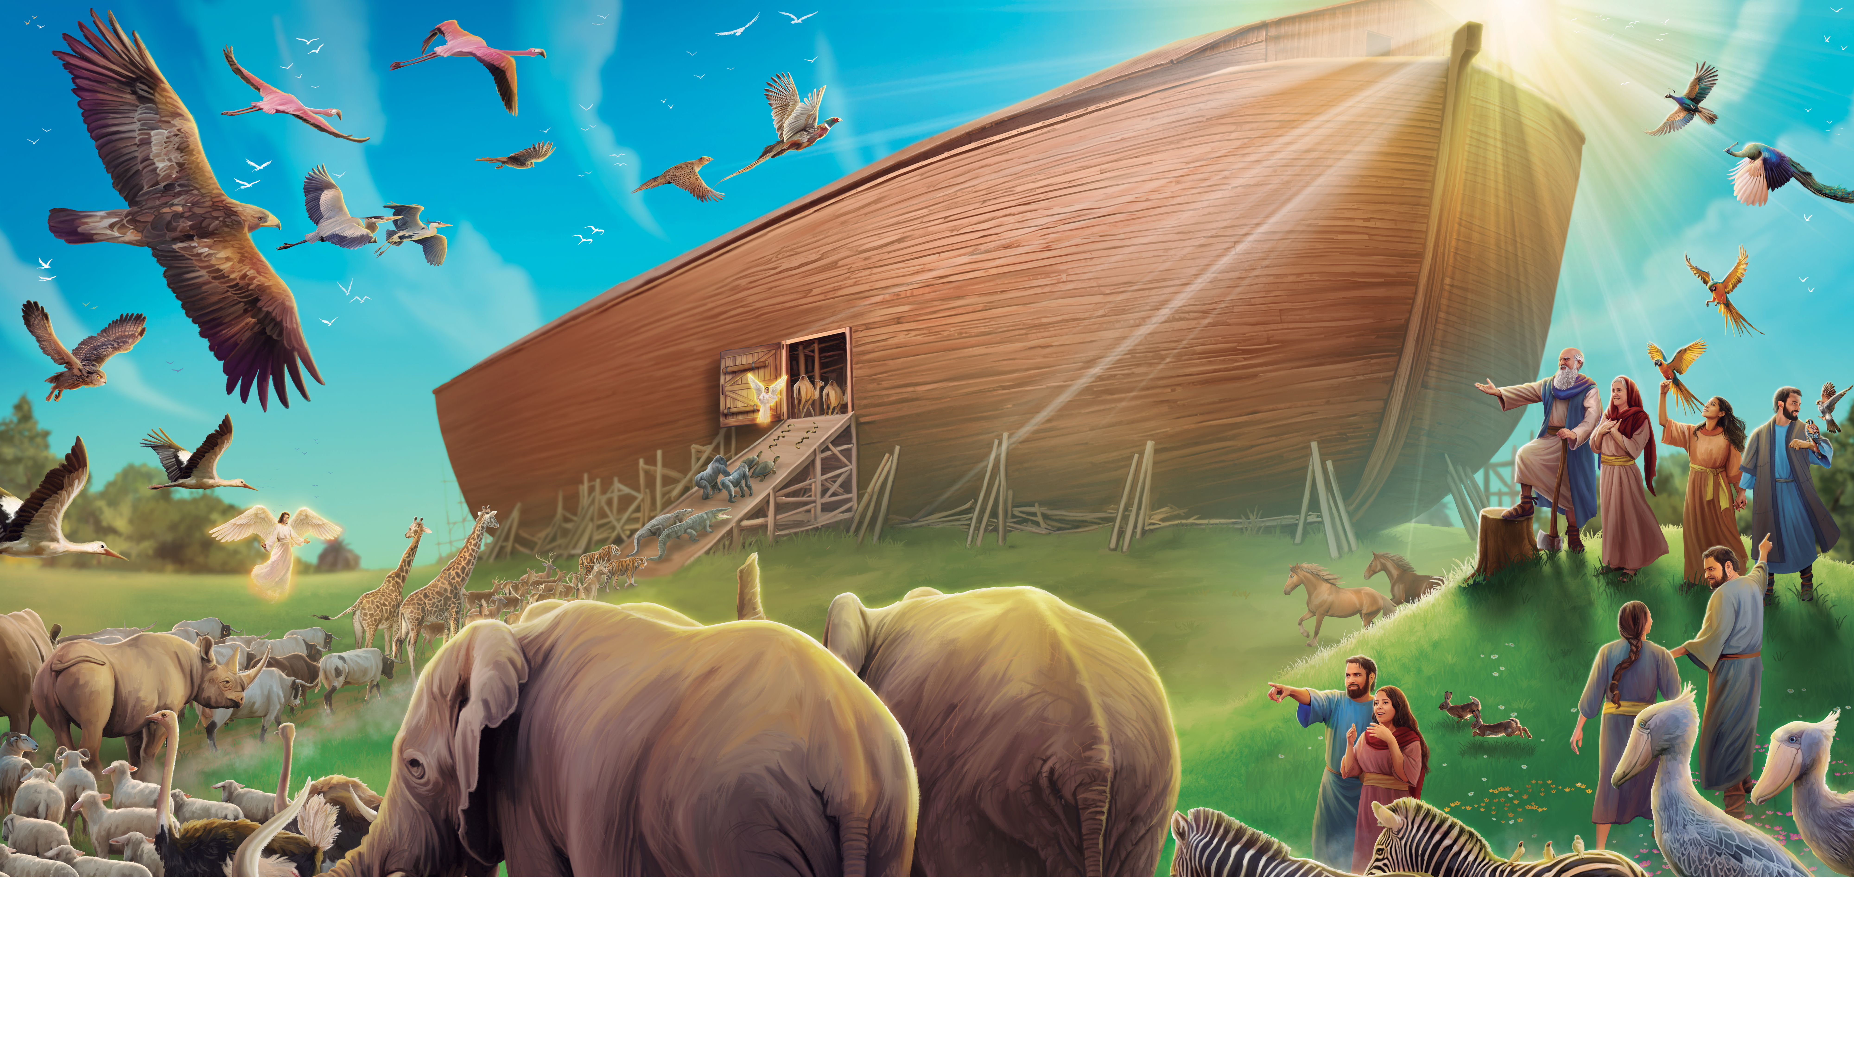
Welcome to Sabbath School

Slide 2
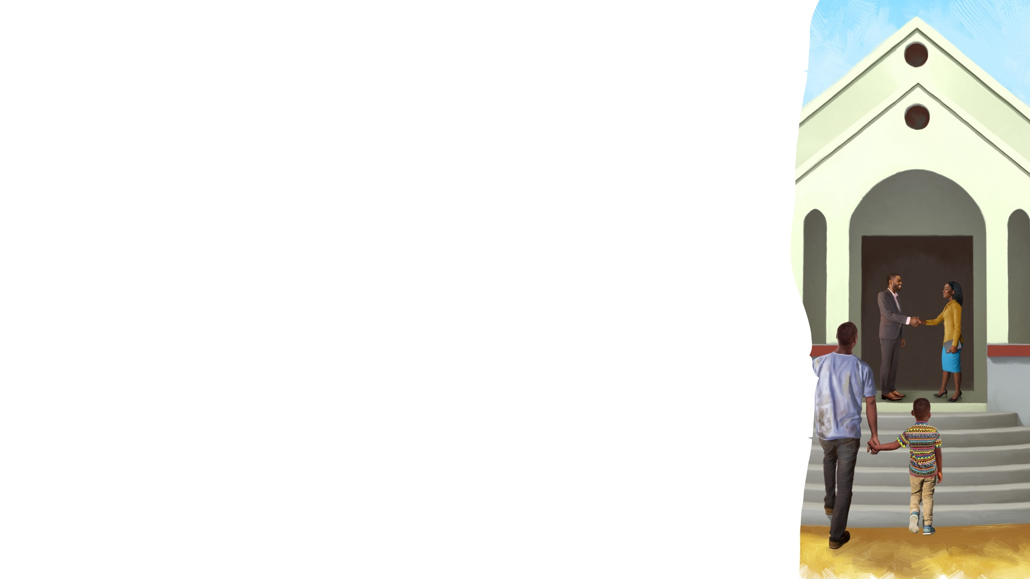

It’s About Love
EARLY ARRIVALS
It’s about love for us,
God’s love for us.
It’s about Jesus’ love for me.
It’s about love for us,
God’s love for us,
That we have everything
Our hearts will ever need.
God loves you so
And wants you to know
He is always by your side.
And that His love is always there,
So you can trust that He will care.
Oh! Won’t you love Him too?
His arms are open wide.
“It’s About Love” by Tammy Cinzio. © 2003 Creation Connection. Used by permission.

Slide 3
EARLY ARRIVALS

Slide 4
Pack it Up
EARLY ARRIVALS
Pack it up and pick it up and put it away.
Now it’s time to listen,
To sing and pray.
It’s so good to be here
And to see you again.
Come, sit down,
Let’s talk about our special Friend.
Come, sit down,
Let’s talk about our special Friend.
“Pack It Up” by Coralie Fraser. Arrangement Copyright © 2025 General Conference Corporation® of Seventh-day Adventists.

Slide 5
Welcome to Sabbath School

Slide 6
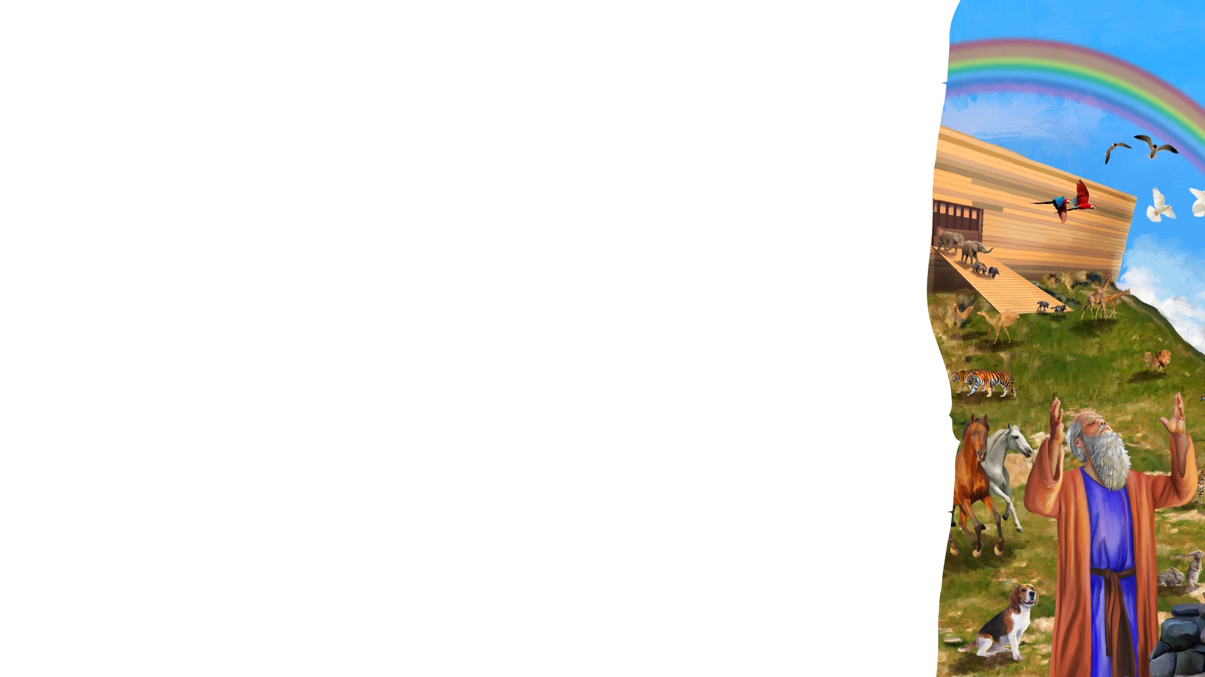
Good Morning Jesus
WELCOME AND SONGS
One, two, three,
Lift up your voice and sing.
Four, five, six,
Let’s say, “Good morning, Jesus.”
Seven, eight, nine,
It’s Sabbath School time.
One, two, three, four, five, six, seven, Eight, nine, ten, let’s sing it again.
(Repeat above)
(Actions or props)
“Good Morning Jesus” by Rosie Smith. Copyright © 2024 General Conference Corporation® of Seventh-day Adventists.

Slide 7
Our God is Amazing
WELCOME AND SONGS
God made the great big elephants And the tiny, crawling ants.
He made the spotty leopards
And the stripy zebras.
He made the fluffy bunnies
And bees to make us honey.
He made the quiet moths
And the lazy, sleepy sloths.
(Continued on next slide.)
(Actions or props)

Slide 8
Our God is Amazing
WELCOME AND SONGS
Our God is amazing!
(Our God is amazing!)
Let us all praise Him.
(Let us all praise Him.)
For the animals, great and small,
Each one different and incredible,
Our God is amazing.
(Continued on next slide.)
(Actions or props)
“Our God Is Amazing” by Rosie Smith. Copyright © 2025 General Conference Corporation® of Seventh-day Adventists.

Slide 9
Our God is Amazing
WELCOME AND SONGS
God made the great big elephants And the tiny, crawling ants.
He made the spotty leopards
And the stripy zebras.
He made the fluffy bunnies
And bees to make us honey.
He made the quiet moths
And the lazy, sleepy sloths.
(Continued on next slide.)
(Actions or props)

Slide 10
Our God is Amazing
WELCOME AND SONGS
Our God is amazing!
(Our God is amazing!)
Let us all praise Him.
(Let us all praise Him.)
For the animals, great and small,
Each one different and incredible,
Our God is amazing.
Our God is amazing.
Our God is amazing.
(Actions or props)
“Our God Is Amazing” by Rosie Smith. Copyright © 2025 General Conference Corporation® of Seventh-day Adventists.

Slide 11
Missionary, Missionary
WELCOME AND SONGS
Some people far away don’t yet know
That our Lord Jesus loves them so. *Missionary, Missionary, will you go
To bring them the good news of Jesus?
*Doctor, Doctor
*Teacher, Teacher
*Pastor, Pastor
*Farmer, Farmer,
*Builder, Builder
To bring them the good news of Jesus?
“Missionary, Missionary” by Rosie Smith. Copyright © 2024 General Conference Corporation® of Seventh-day Adventists.

Slide 12
Happy Birthday
WELCOME AND SONGS
Happy birthday, happy birthday,
Happy birthday to you.
Jesus loves you dear ___________.
Happy birthday to you.
(Repeat above)
“Happy Birthday” by Janet Sage, copyright © 2001 North American Division Corporation of Seventh-day Adventists. From Little Voices Praise Him, #39. Used by permission.

Slide 13
Visitor Song
WELCOME AND SONGS
We have a new friend
With us today.
We have a new friend.
Let’s smile and wave.
We welcome you to Sabbath School.
We’re glad you came.
We welcome you,
And hope to see you again. (x2)
“Visitor Song” by Rosie Smith. Copyright © 2024 General Conference Corporation® of Seventh-day Adventists.

Slide 14
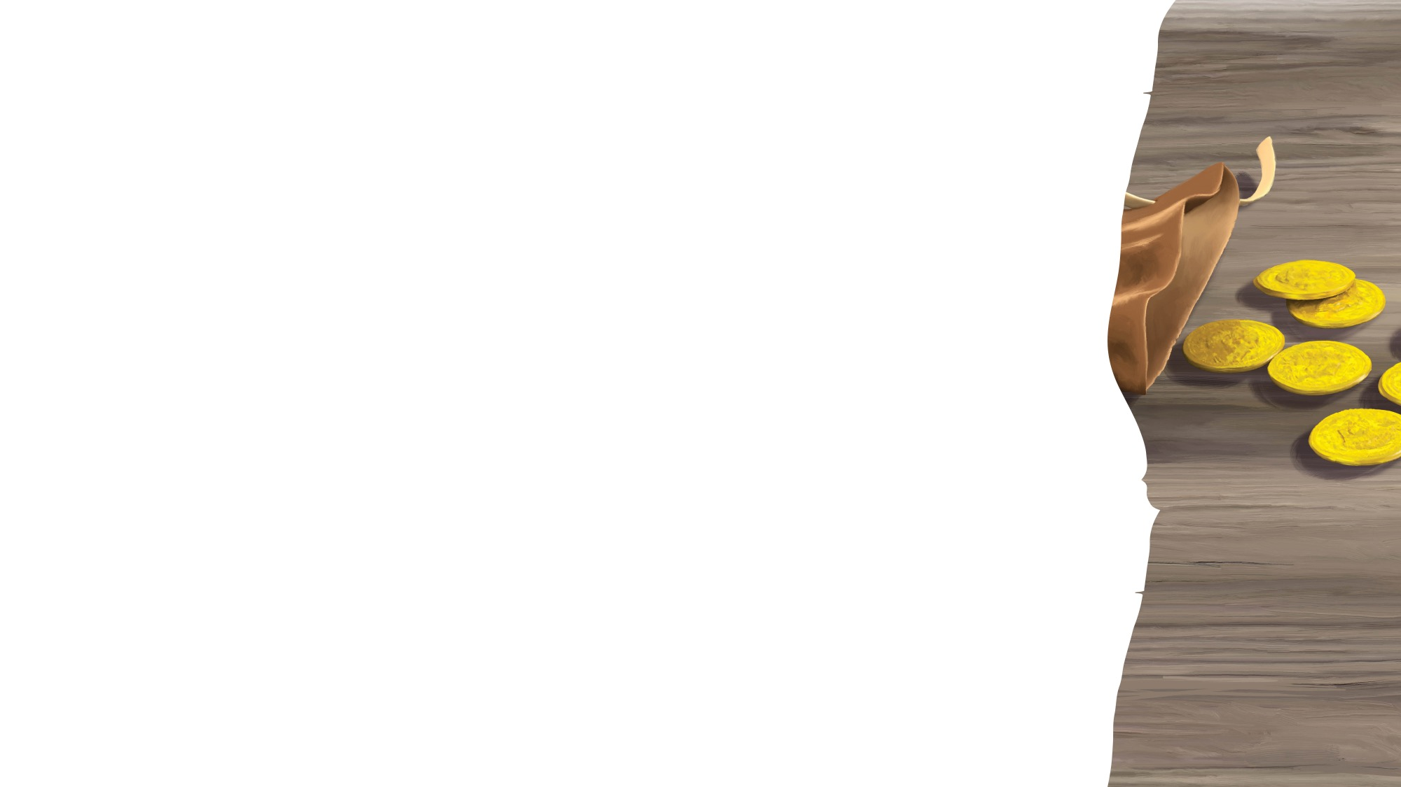
MISSION
FAST FACT
& OFFERING CHART

Slide 15
For Jesus
OFFERING
For Jesus, I want to bring
My money as an offering.
For Jesus, I want to bring
My money as an offering.
An offering to worship my King
To show I’m thankful for His blessings.
An offering to worship my King
To show I’m thankful for His blessings.
(Continued on next slide.)

Slide 16
For Jesus
OFFERING
For mission, I want to bring
My money as an offering.
For mission, I want to bring
My money as an offering.
An offering to worship my King
To show I’m thankful for His blessings.
An offering to worship my King
To show I’m thankful for His blessings. (X2)
“For Jesus” by Rosie Smith. Copyright © 2024 General Conference Corporation® of Seventh-day Adventists.

Slide 17
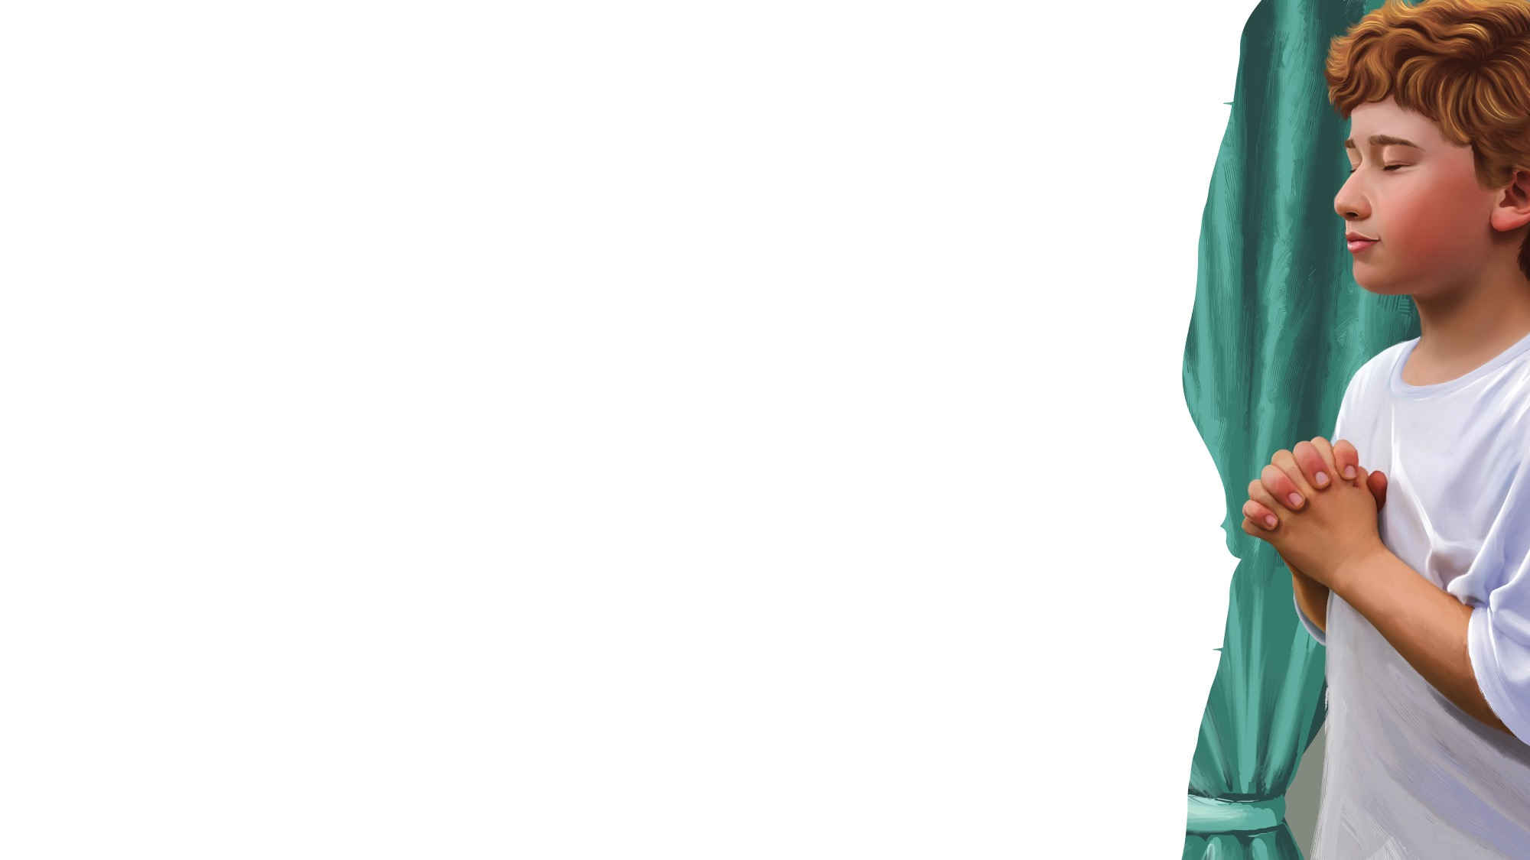
Let’s Pray
PRAYER TIME
Anytime, anywhere,
We can say a little prayer
To our Father in heaven,
Who hears us.
(Repeat above)
Let’s pray. (Fold your hands.)
Let’s pray. (Close your eyes.)
Let’s pray.
“Let’s Pray” by Rosie Smith. Copyright © 2024 General Conference Corporation® of Seventh-day Adventists.

Slide 18

GOD’S
WORD

Slide 19
GOD’S WORD
The Greatest Treasure
If I dug down deep in the dirt,
I would never find
A treasure as great as God’s Word, Full of wisdom and truth.
It’s better than diamonds,
It’s better than gold,
The greatest story ever told,
It’s the Bible.
Yes, it’s the Bible.
(Repeat above)
“The Greatest Treasure” by Rosie Smith. Copyright © 2024 General Conference Corporation® of Seventh-day Adventists.

Slide 20
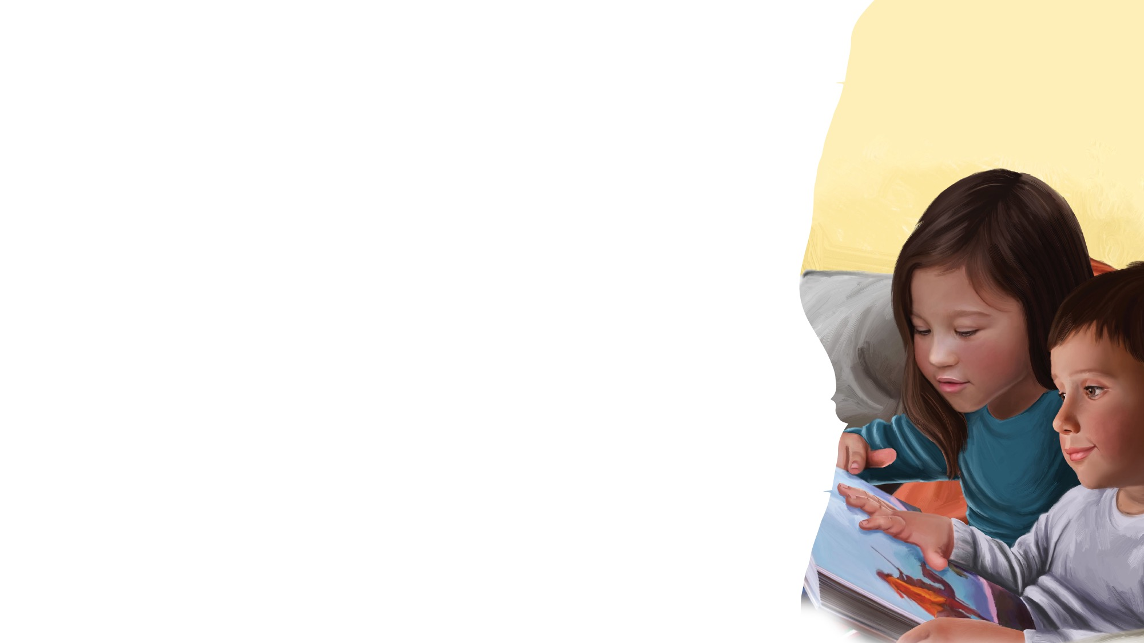
MEMORY VERSE
I will never
leave you
nor forsake you.
Hebrews 13:5b

Slide 21
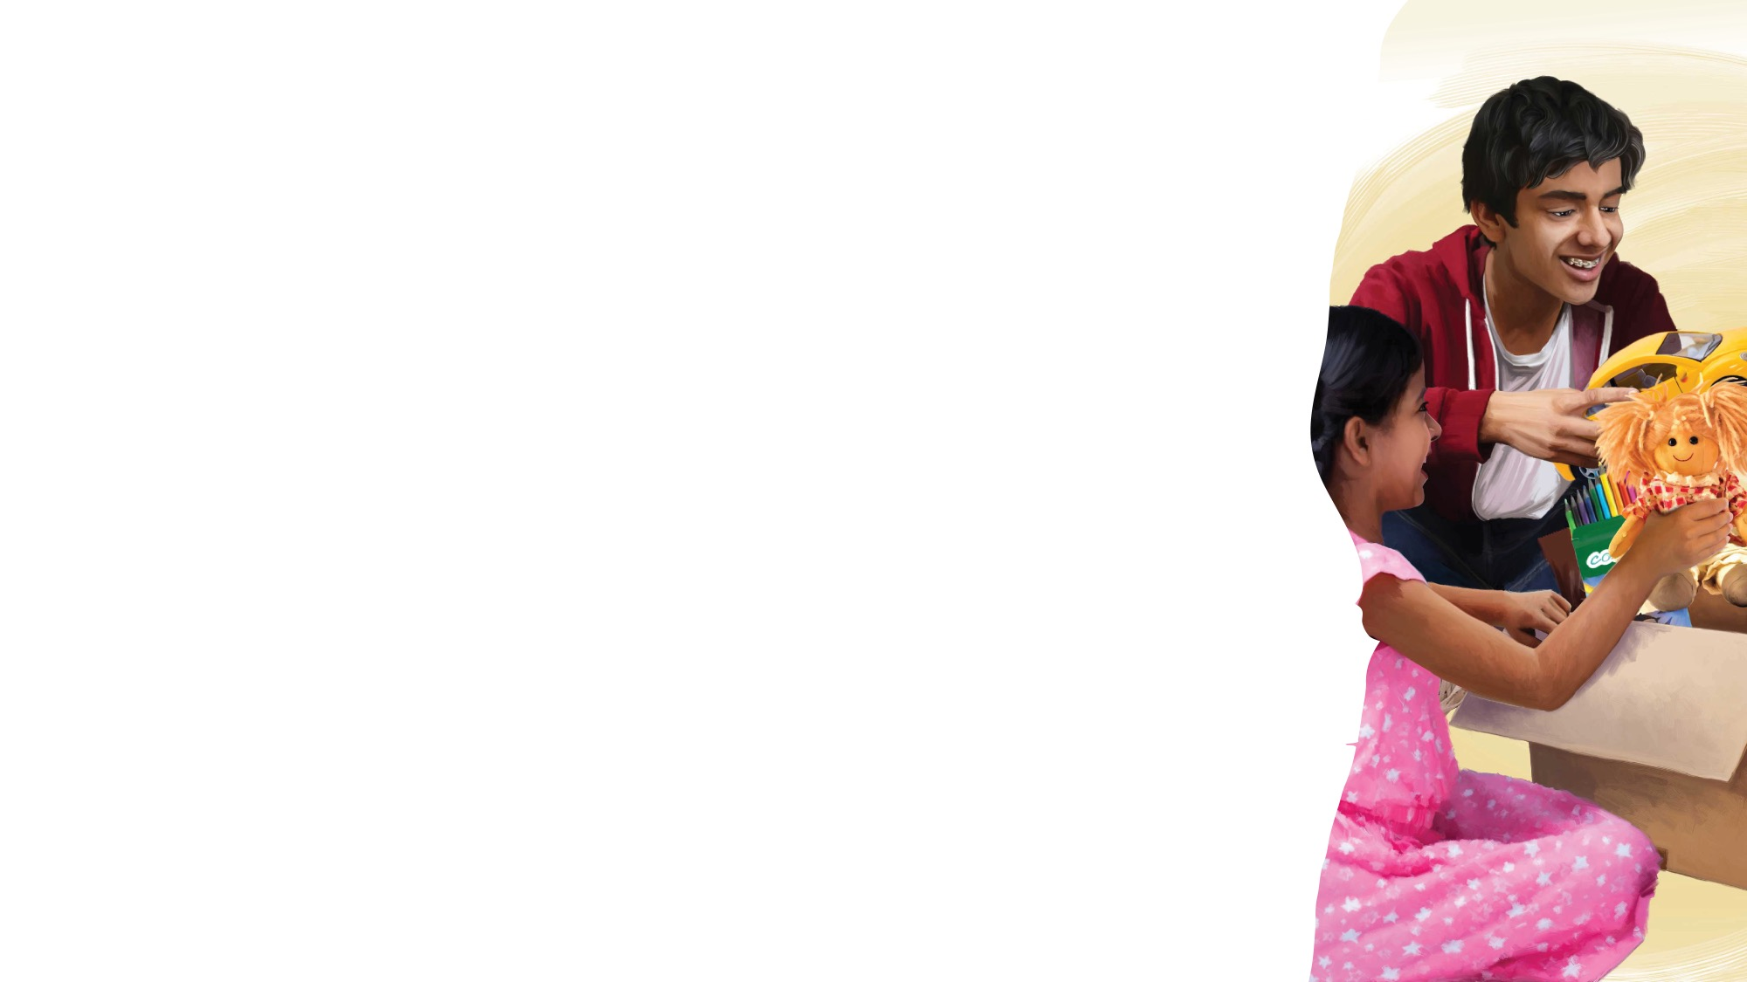
SECRET
SURPRISE
BOX

Slide 22
BIG IDEA
God is loving. He is always with me.

Slide 23
TELL
THE
STORY

Slide 24
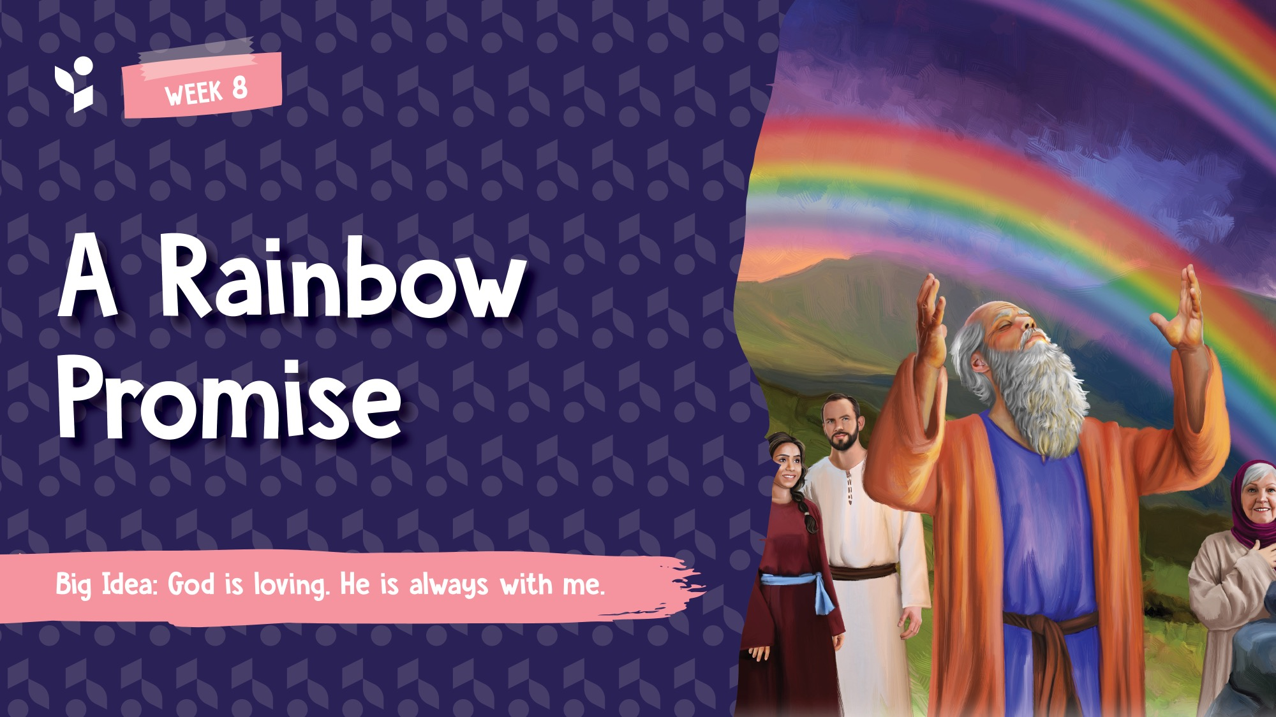

Slide 25
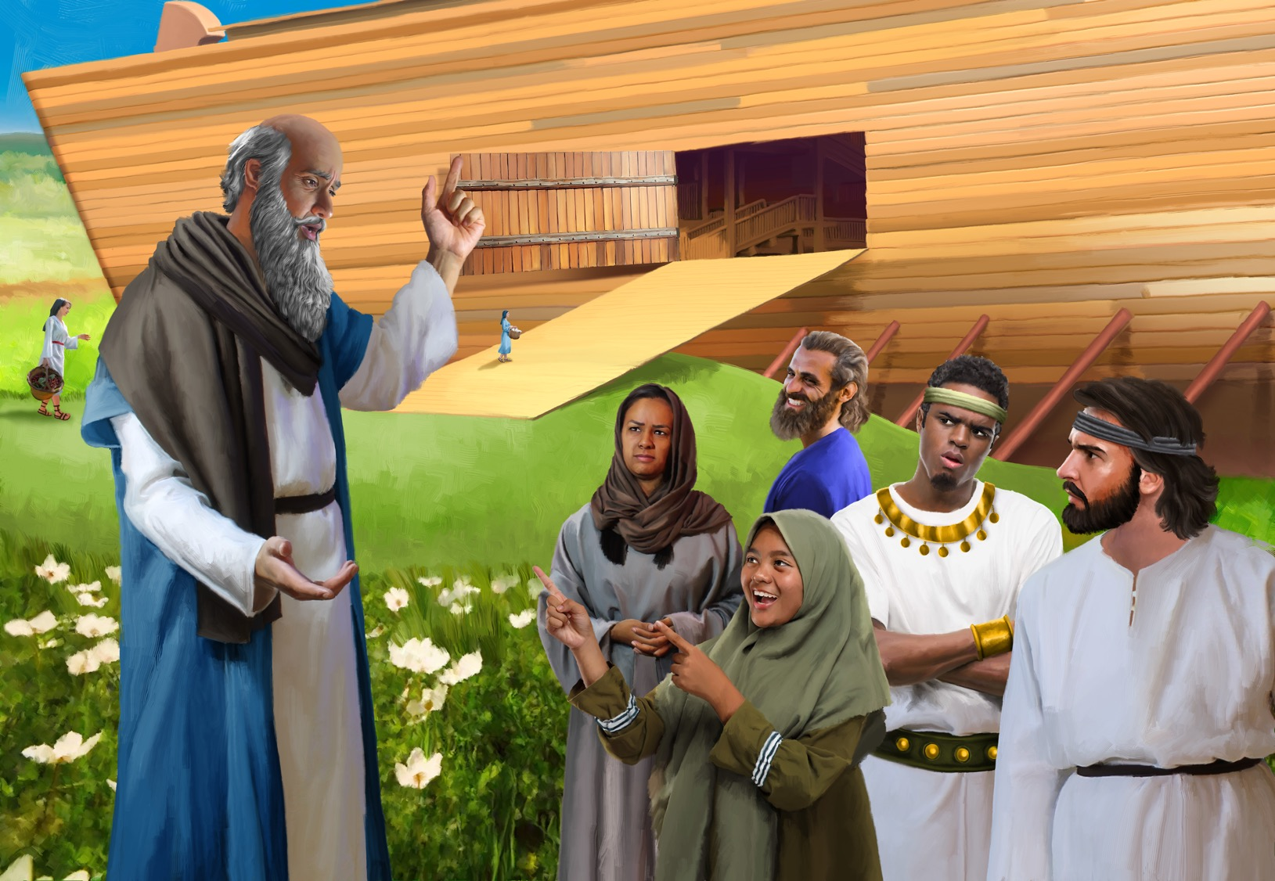

Slide 26
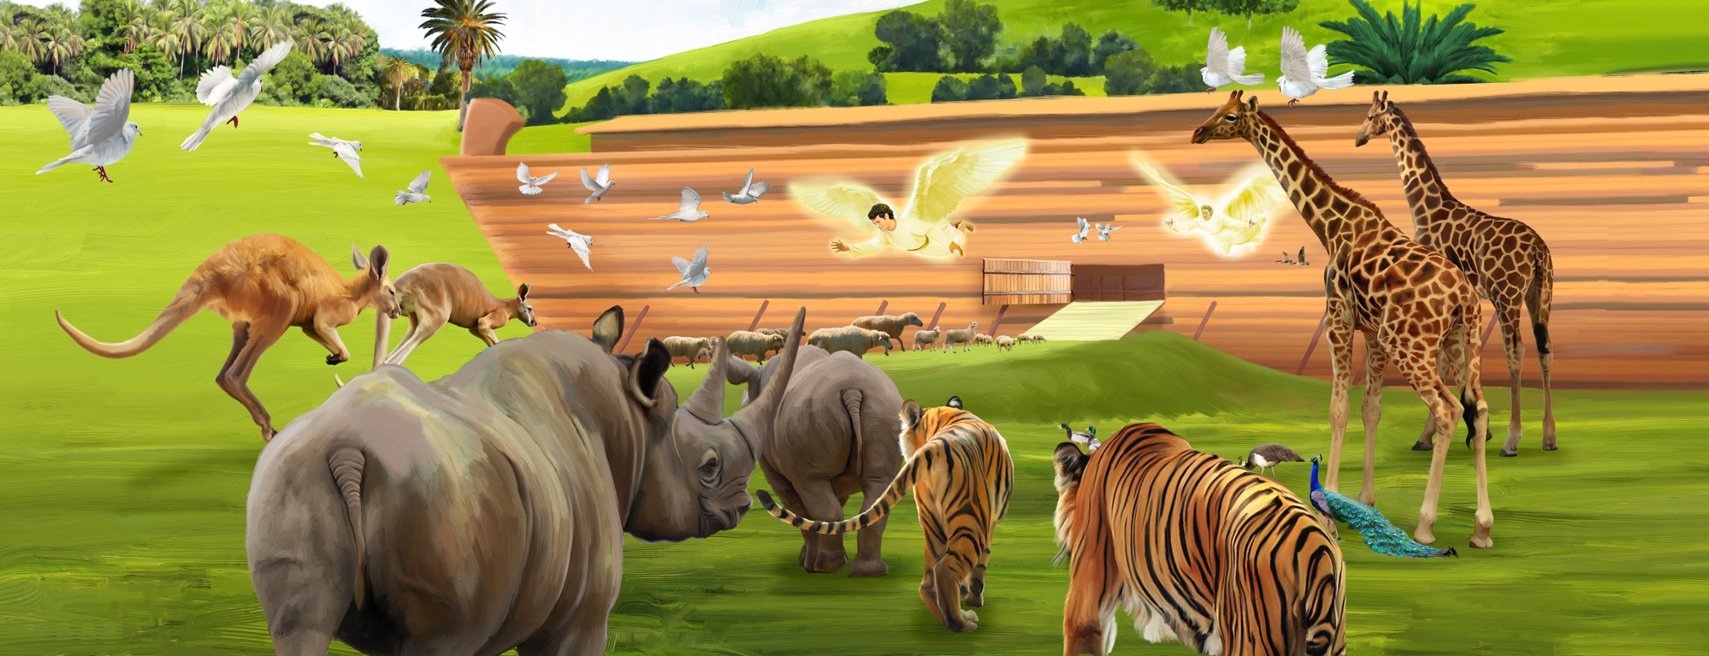

Slide 27
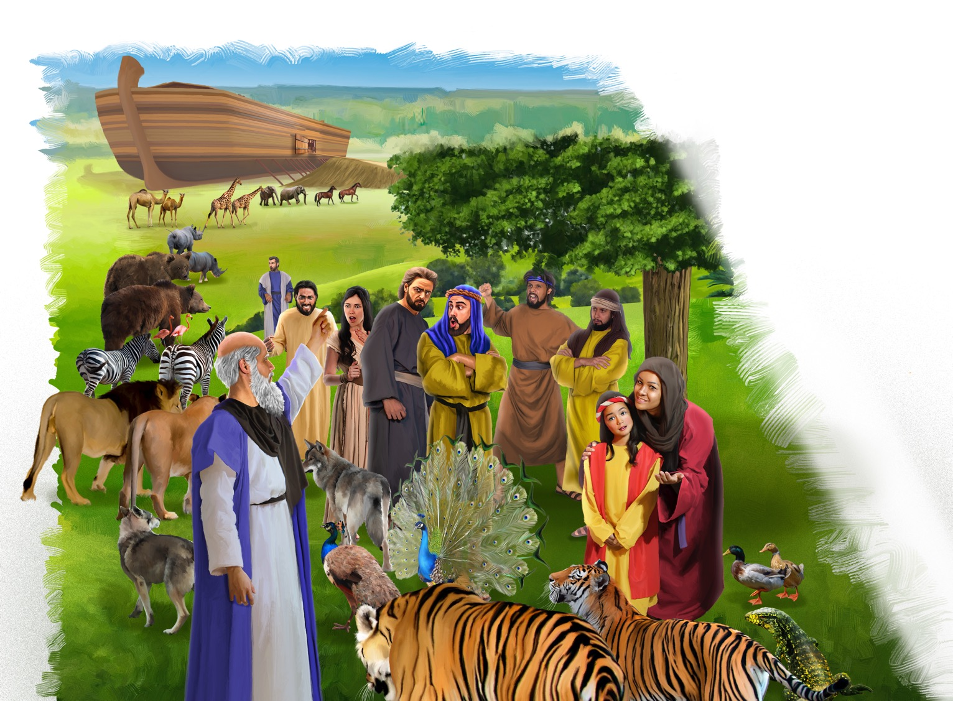

Slide 28
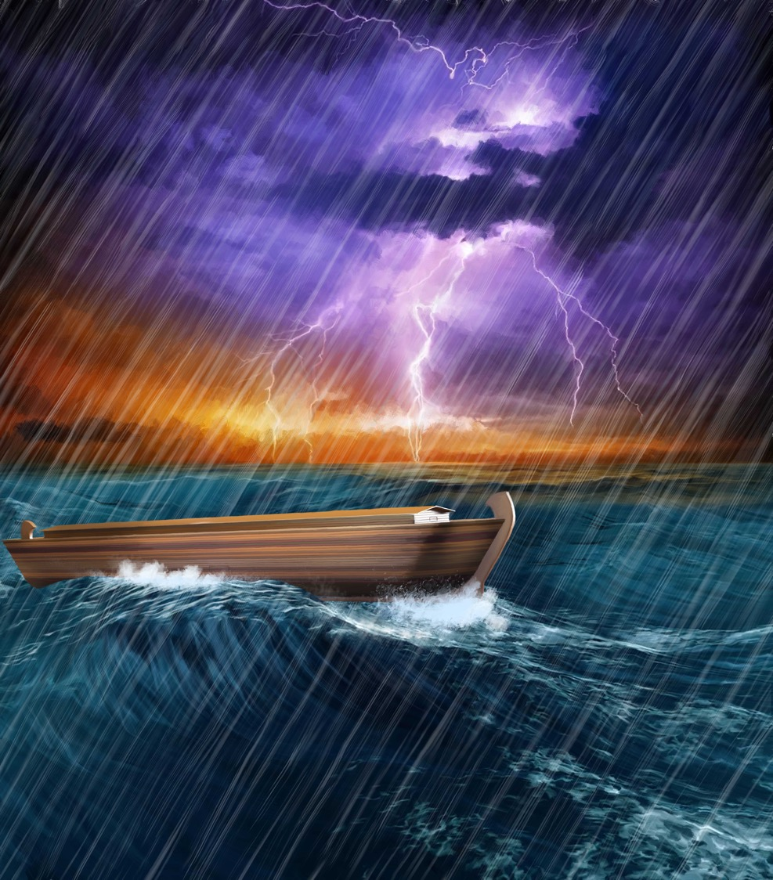

Slide 29
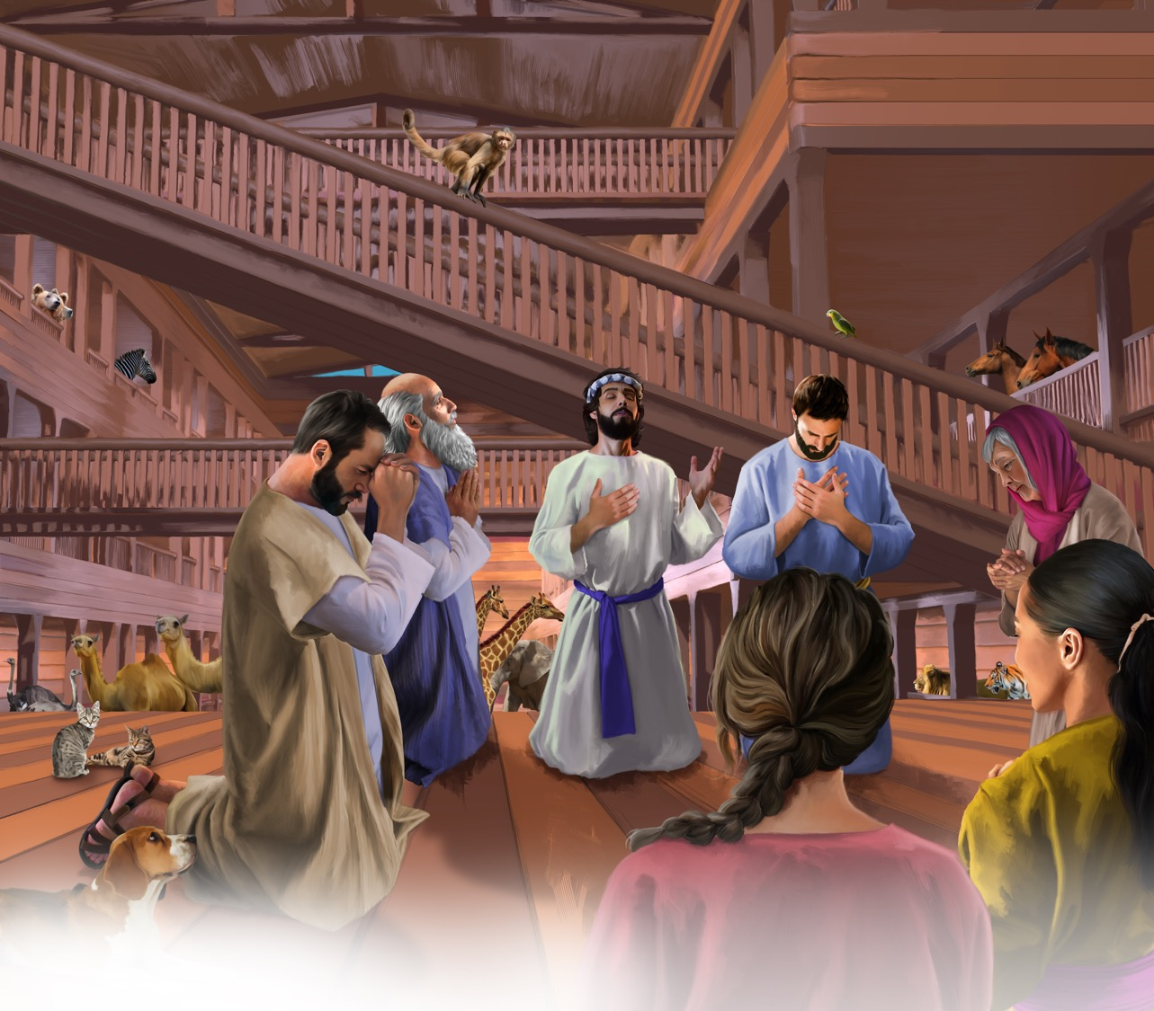

Slide 30
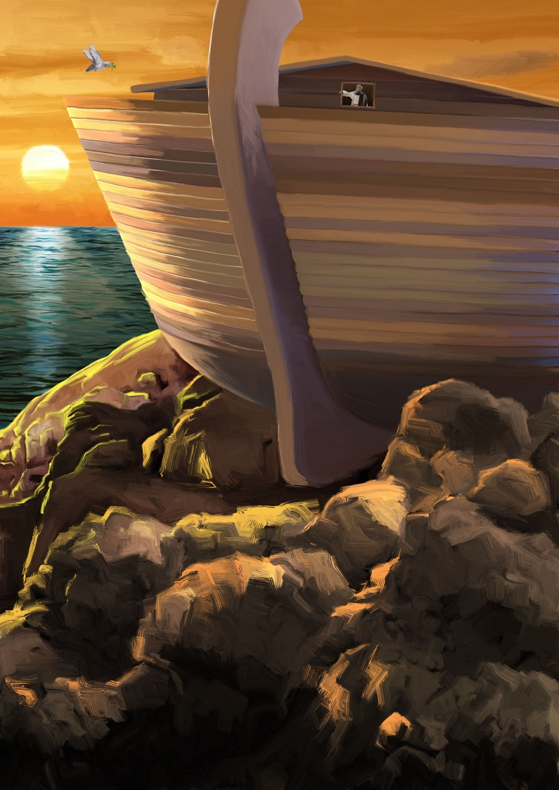

Slide 31
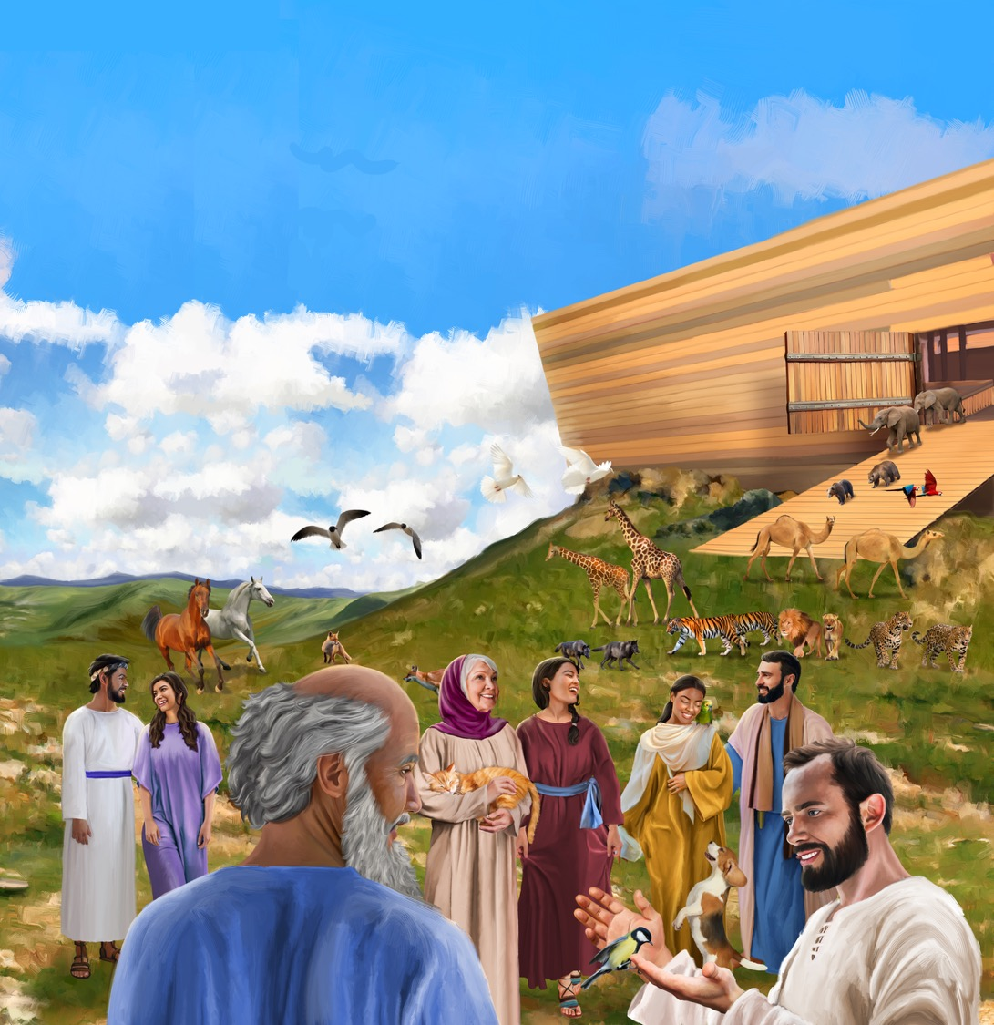

Slide 32
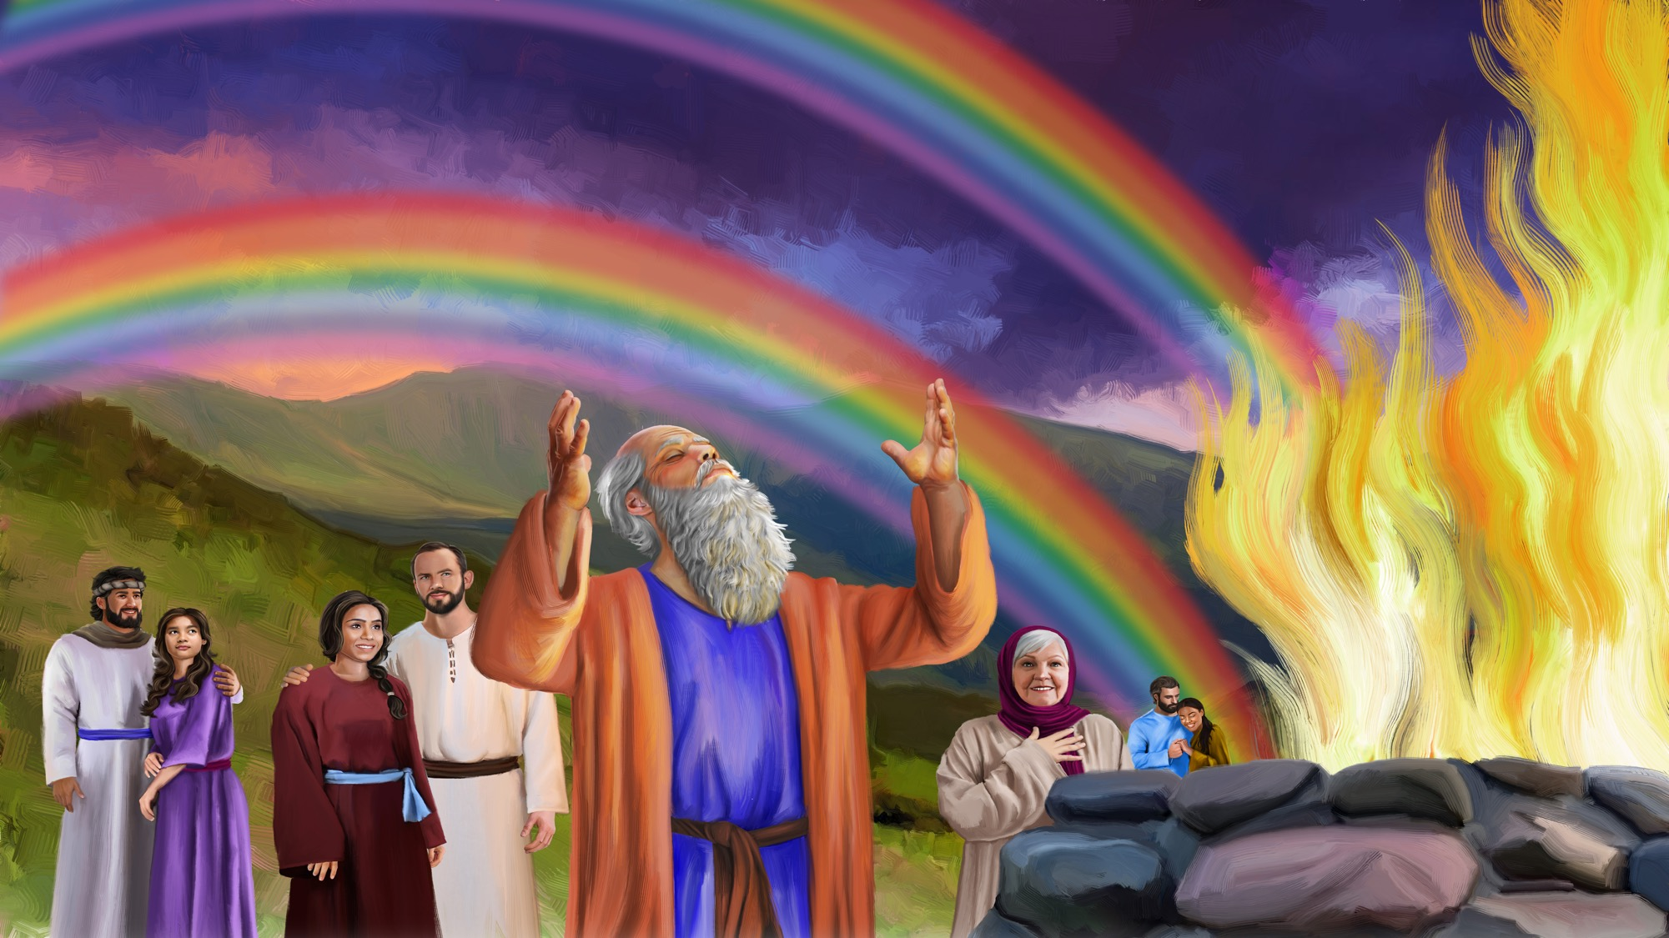

Slide 33
STORY
EXPLORER BOX

Slide 34
BIG IDEA
God is loving. He is always with me.

Slide 35

NATURE COLLECTOR CARD

Slide 36
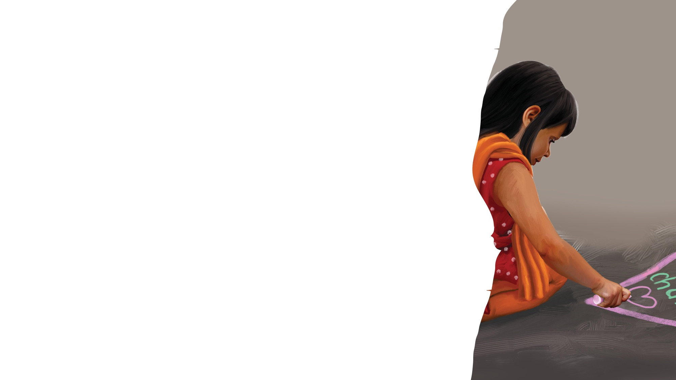
CRAFT
TIME

Slide 37
REVIEW

Slide 38
BIG IDEA
God is loving. He is always with me.

Slide 39
MISSION CHALLENGE

Slide 40
Goodbye Song
CLOSING
Sabbath School has come to an end
(Clap, clap).
It’s time to say “Good-bye” to my friends (Clap, clap).
God bless you till we meet again.
God bless you.
(Repeat above)
“Goodbye Song” by Rosie Smith. Copyright © 2024 General Conference Corporation® of Seventh-day Adventists.

Slide 41
Prayer

